Slide 1

SECD2523 DATABASE
TOPIC 2
THE RELATIONAL MODEL AND DATABASE DESIGN
Content adapted from Connolly, T., Begg, C., 2015. Database Systems: A Practical Approach to Design, Implementation, and Management, Global Edition. Pearson Education.

Slide 2
LECTURE LEARNING OUTCOME
By the end of this lecture, students should be able to:
01
Terminology of relational model.
02
How tables are used to represent data.
03
Properties of database relations.
04
How to identify candidate, primary, foreign keys.
05
Meaning of entity integrity and referential integrity.
06
Purpose and advantages of views.

Slide 3
LECTURE LEARNING OUTCOME
By the end of this lecture, students should be able to:
07
Define and describe the stages of the database system development life cycle.
08
Define the activities and deliverables in the main phases of database design: conceptual, logical and physical design
09
Build a conceptual data model based on information given in a view of the enterprise using ER Modeling.
10
Validate result of conceptual model to ensure it is a true and accurate representation of a view of the enterprise.
11
Document the process of conceptual database design.

Slide 4
01
THE RELATIONAL MODEL
02
DATABASE DESIGN
- CONCEPTUAL DESIGN

Slide 5
Introduction
DBMS generations:
Third generation
(Object-oriented DBMS, Object-relation DBMS)
Second generation (relational DBMS (RDBMS))
– late 70s
First generation (hierarchical, network DBMS) – 1960s
RDBMS is based on relational data model concepts by E.F. Codd (1970)
Simple logical structure
Sound theoretical foundation
Data is logically structured within relations

Slide 6
Relational Model Terminology
A relation is a table with columns and rows.
  Only applies to logical structure of the database, not the physical structure.
Attribute is a named column of a relation.
Domain is the set of allowable values for one or more attributes.

Slide 7
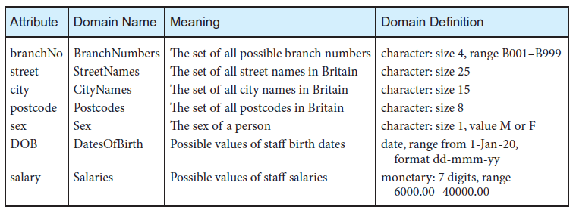
Examples of Attributes & Domains

Slide 8
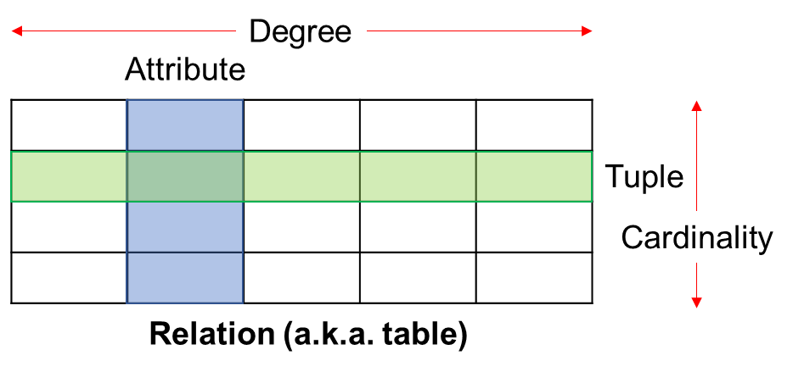
Relational Model Terminology
Tuple is a row of a relation.
Degree is the number of attributes in a relation.
Cardinality is the number of tuples in a relation.
Relational Database is a collection of relations that is appropriately structured (normalized) with distinct relation names.

Slide 9
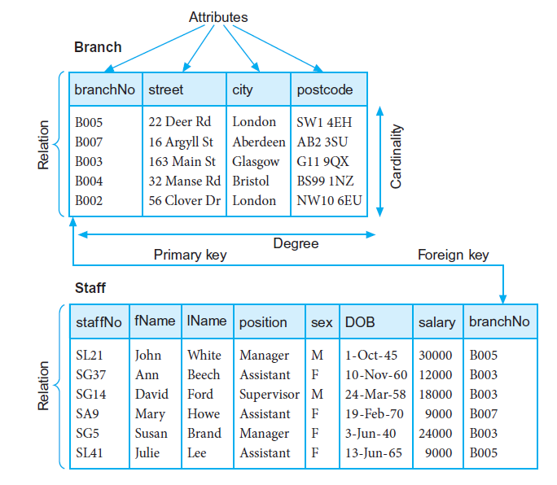
Examples

Slide 10
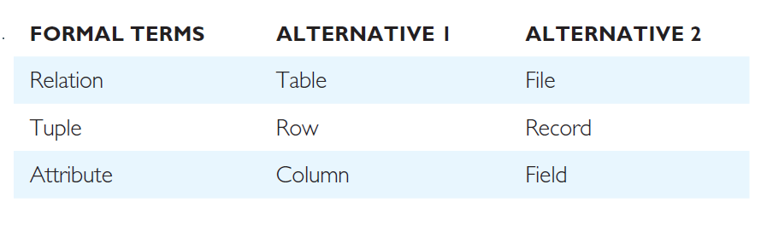
Alternative Terminology
Table: Alternative terminology for relational model terms

Slide 11

Database Relations

Slide 12
Database Relations
Relation schema
  Named relation defined by a set of attribute and domain name pairs.
  Common convention:
    RelationName (attribute_1, attribute_2,….., attribute_n)
    Example: Branch (branchNo, street, city, postcode)
Relational database schema
  Set of relation schemas, each with a distinct name.
Relation instance
  A tuple at a specific moment of time
  Eg: (B005, 55 Jln Dobi, Johor Bahru, 80100)

Slide 13
Examples
Relation schema
Relational database schema
Relation instance

Slide 14
Properties of Relations
Relation name is distinct from all other relation names in relational schema.
Each cell of relation contains exactly one atomic (single) value.
Each attribute has a distinct name.
Values of an attribute are all from the same domain.
Each tuple is distinct; there are no duplicate tuples.
Order of attributes has no significance.
Order of tuples has no significance, theoretically.

Slide 15
Relational Keys

Slide 16
Relational Keys
Relational keys
  One or more attributes in a relation that uniquely identifies each tuple in a relation
  Types:
    Superkey
    Candidate key
    Composite key
    Primary key
    Alternate key
    Foreign key

Slide 17
Relational Keys
Superkey
  An attribute, or a set of attributes, that uniquely identifies a tuple within a relation.
Identify superkeys that contain only the minimum number of attributes necessary for unique identification

Slide 18
Relational Keys
Superkey example
  Branch (branchNo, street, city, postCode)
  Each branch has a unique branch number
  What is/are superkey(s) for relation Branch?
    Analyze each attribute singularly, given a value for the attribute, determine whether a unique tuple can be derived from the relation, if so, then attribute is a superkey
    If none of the attribute (singularly) can be a candidate key, then try to combine two (or more) attributes and determine whether the combined attributes can derive a unique tuple, if so, then the combined attributes is a superkey.

Slide 19
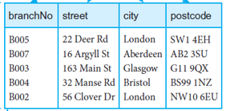
Example of Superkey:

Slide 20
Relational Keys
Candidate Key
  A superkey such that no proper subset is a superkey within the relation.
Two properties:
  In each tuple of relation R, values of K uniquely identify that tuple (uniqueness).
  No proper subset of K has the uniqueness property (irreducibility).
If subset of K is a superkey itself, then K is not a candidate key
There can be more than one candidate keys in a relation

Slide 21
Relational Keys
Example (candidate key - CK):
  Assume we have this list of superkeys for a relation. Determine whether these superkeys are candidate keys.
    branchNo
    branchNo, city
    postCode, branchNo
    1st superkey branchNo
      This superkey has no subset that is a superkey itself, hence branchNo is a CK
    2nd superkey branchNo, city
      This superkey has a subset that is a superkey itself (i.e. branchNo), hence branchNo, city is NOT a CK
    3rd superkey postCode, branchNo
      This superkey has a subset that is a superkey itself (i.e. branchNo), hence postCode, branchNo is NOT a CK

Slide 22
Relational Keys
Composite Key
  When a key consists of more than one attribute.
Primary Key (PK)
  The candidate key that is selected to identify tuples uniquely within the relation.
Alternate Key
  The candidate keys that are not selected to be the primary key.

Slide 23
Relational Keys
Foreign Key
  An attribute, or set of attributes, within one relation that matches the candidate key of some (possibly the same) relation.
Indicate a relationship between relations. E.g:
  Branch (branchNo, street, city, postCode)
    PK branchNo
  Staff (staffNo, fName, lName, position, sex, DOB, salary, branchNo)
    PK staffNo
    FK branchNo references Branch(branchNo)

Slide 24
Relational Keys
Superkey
Candidate Key
Primary Key
Foreign Key

Slide 25
Integrity Constraints
Integrity constraints are to ensure correctness / accuracy of data.
  Domain constraints; integrity rules.
Integrity rules
  Constraints or restrictions that apply to all instances of the database.
  Two principal rules:
    Entity integrity
    Referential integrity

Slide 26
Integrity Constraints
Null
Represents value for an attribute that is currently “unknown” or not applicable for tuple.
Deals with incomplete or exceptional data.
Represents the absence of a value and is not the same as zero or spaces, which are values.

Slide 27
Integrity Constraints
Entity Integrity
  In a base relation, no attribute of a primary key can be null.
Referential Integrity
  If foreign key exists in a relation, the foreign key value:
    must match a candidate key value of some tuple in its home relation; OR
    foreign key value must be wholly null.
General Constraints
  Additional rules specified by users or database administrators that define or constrain some aspect of the enterprise.

Slide 28
Views
Base Relation
A named relation corresponding to an entity in conceptual schema, whose tuples are physically stored in database.
View
The dynamic result of one or more relational operations operating on base relations to produce another relation.

Slide 29
Views
A virtual relation that does not necessarily actually exist in the database but is produced upon request, at time of request.
Contents of a view are defined as a query on one or more base relations.
Views are dynamic, meaning that changes made to base relations that affect view attributes are immediately reflected in the view.

Slide 30
Purpose of Views
Provides powerful and flexible security mechanism by hiding parts of database from certain users.
Permits users to access data in a customized way, so that same data can be seen by different users in different ways, at same time.
Can simplify complex operations on base relations.

Slide 31
Updating Views
All updates to a base relation should be immediately reflected in all views that reference that base relation. If view is updated, underlying base relation should reflect change.
There are restrictions on types of modifications that can be made through views:
  Updates are allowed if query involves a single base relation and contains a candidate key of base relation.
  Updates are not allowed when query involves multiple base relations.
  Updates are not allowed when query involves aggregation or grouping operations.

Slide 32
Summary
Terminologies – relation, relational schema
Keys – super key, candidate key, composite key, primary key, foreign key, alternate key
Integrity constraint
View

Slide 33



01
THE RELATIONAL MODEL
02
DATABASE DESIGN
- CONCEPTUAL DESIGN

Slide 34
Stages of Database Application Lifecycle
Database planning
System definition
Requirements collection
and analysis
DBMS selection
Conceptual database design
Application design
Logical database design
Physical database design
Focus is this course
Database design
Prototyping (optional)
Implementation
Data conversion and loading
Testing
Operational maintenance

Slide 35
1) Database Planning
Management activities that allow stages of database application lifecycle to be realized as efficiently and effectively as possible.
Must be integrated with overall information system (IS) strategy of the organization.

Slide 36
1) Database Planning
Define a clear mission statement
  major aims of database application
  clarify purpose of the database project
  provides clearer path towards the efficient and effective creation of required database application.
  Defined by ones who are driving database project – director or owner of the project
Identify mission objectives
  What tasks that must be supported by the system
  Each objective is one specific task

Slide 37
1) Database Planning
Other information accompanied in mission statement and objectives:
  The work to be done
  The resources with which to do it
  The money to pay for it
Database planning should also include development of standards that govern:
  how data will be collected,
  how the format should be specified,
  what necessary documentation will be needed,
  how design and implementation should proceed.

Slide 38
2) System Definition
Describes scope and boundaries of database application and the major user views.
  System boundaries should involve current and future application areas and users
User view defines what is required of a database application from the perspective of:
  a particular job role (such as Manager or Supervisor) or
  enterprise application area (such as marketing, personnel, or stock control)

Slide 39
2) System Definition
Database application may have one or more user views.
Identifying user views helps ensure that no major users of the database are forgotten when developing requirements for new application.
A user view provides requirements:
  What data to be included in the system
  What transactions to be performed on the data
  Requirements may be distinct or overlap with other views

Slide 40
3) Requirements Collection and Analysis
The process of collecting and analyzing information about the part of organization to be supported by the database application and using this information to identify users’ requirements of new system.
Information is gathered for each major user view including:
  a description of data used or generated;
  details of how data is to be used/generated;
  any additional requirements for new database application.

Slide 41
3) Requirements Collection and Analysis
Information is analyzed to identify requirements to be included in new database application
  Documented in a Requirements specification for new database system
  Presented in a structured/organized using requirement specification techniques, such as SAD techniques, DFD and HIPO charts
Three main approaches in requirements collections and analysis from multiple user views:
  centralized approach;
  view integration approach;
  combination of both approaches.

Slide 42
3) Requirements Collection and Analysis
Centralized approach
  Requirements for each user view are merged into a single set of requirements for the new database system.
  A global data model is created based on the merged requirements (which represents all user views).
  Generally, this approach is preferred when there is a significant overlap in requirements for each user view and the database system is not overly complex.

Slide 43
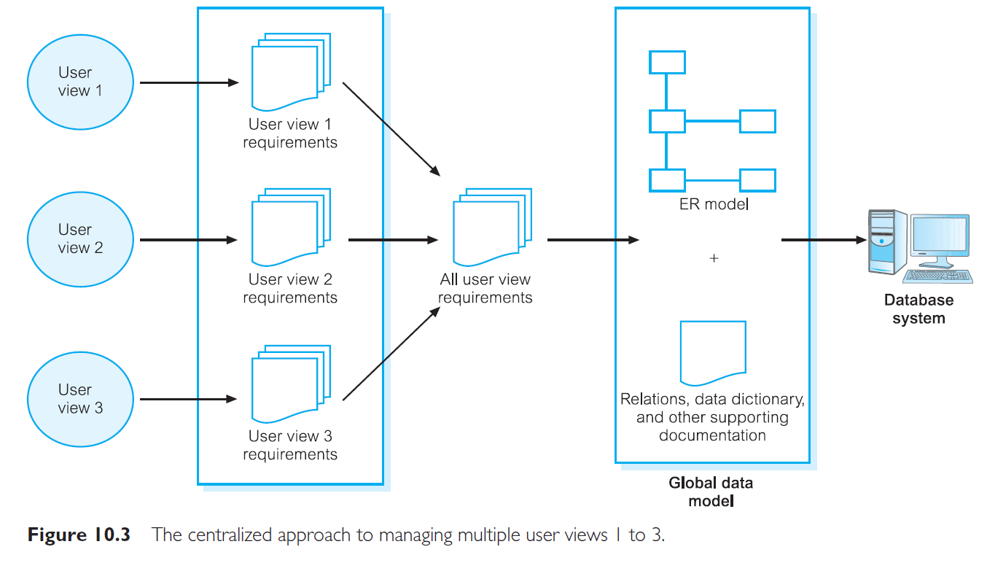
3) Requirements Collection and Analysis
Centralized Approach

Slide 44
3) Requirements Collection and Analysis
View integration approach
  Requirements for each user view are used to build a separate data model.
  Data model representing single user view is called a local data model, composed of diagrams and documentation describing requirements of a particular user view of database.
  Local data models are then merged to produce a global data model, which represents all user views for the database.

Slide 45
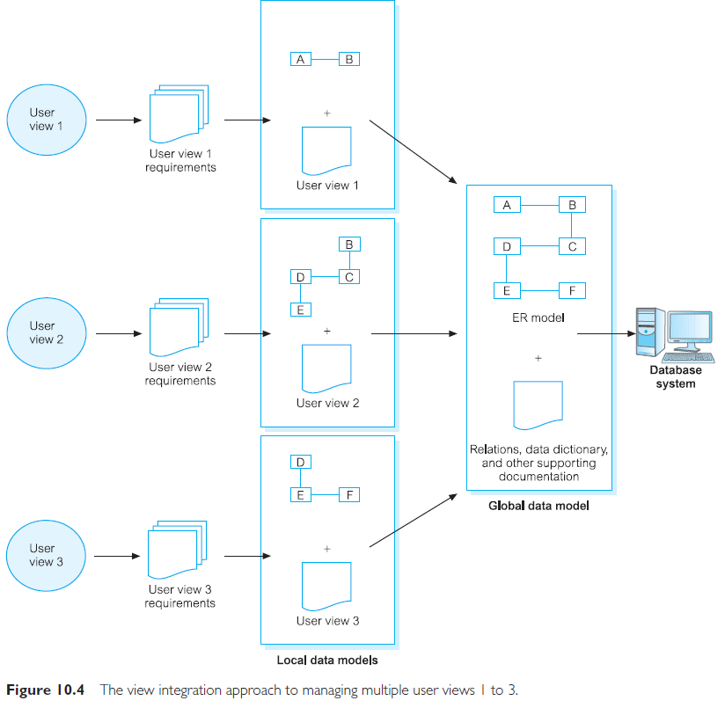
3) Requirements Collection and Analysis
View integration approach

Slide 46
4) Database Design
The process of creating a design for a database that will support the enterprise’s operations and objectives.
Major aims:
  Represent data and relationships between data required by all major application areas and user groups.
  Provide data model that supports any transactions required on the data.
  Specify a minimal design that is appropriately structured to achieve stated performance requirements for the system (such as response times).

Slide 47
4) Database Design
Approaches include:
Top-down
  Starts with developing data models which contain high-level entities and relationships.
  Then refine this high-level data models into a lower-level entities, relationships and attributes.
  Use Entity Relationship Model (ERM)
Bottom-up
  Begins at the fundamental analysis of the associations between attributes
  Grouped into relations that represent types of entities and relationship between entities
  Use Normalization process
Inside-out
  Begins with identifying major entities
  Then spreading out to consider other entities, attributes associated to those first identified.
Mixed
The mixed strategy approach uses both the bottom-up and top-down approach for various parts of the model before finally combining all parts together.

Slide 48
4) Database Design
Main purposes of data modeling include:
  to assist in understanding the meaning (semantics) of the data;
  to facilitate communication about the information requirements.
Building data model requires answering questions about entities, relationships, and attributes.
  A data model ensures we understand:
    each user’s perspective of the data;
    nature of the data itself, independent of its physical representations;
    use of data across user views.

Slide 49
4) Database Design
Three phases of database design:
  Conceptual, Logical and Physical
Conceptual
  Process of constructing a model of information used in an enterprise, independent of all physical considerations.
  Entity Relationship Model; Data dictionary
Logical
  Process of constructing a model of information used in an enterprise based on a specific data model (e.g. relational), but independent of a particular DBMS and other physical considerations.
  Normalized database (relational) schemas
Physical
  Process of producing a description of the implementation of the database on secondary storage; it describes the base relations, file organizations, and indexes design used to achieve efficient access to the data, and any associated integrity constraints and security measures.

Slide 50
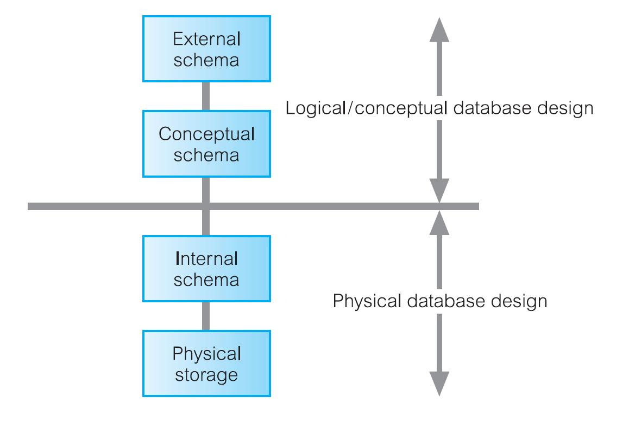
Three-level ANSI-SPARC Architecture and Phases of Database Design

Slide 51
Other Stages
DBMS selection
Application design – User interface (UI) design and application program design
Prototyping
Implementation
Data Conversion and loading
Testing
Operational Maintenance

Slide 52


01
THE RELATIONAL MODEL
02
DATABASE DESIGN
- CONCEPTUAL DESIGN

Slide 53
Design Methodology
Structured approach that uses procedures, techniques, tools, and documentation aids to support and facilitate the process of design.
Database design methodology has 3 main phases:
  Conceptual database design;
  Logical database design;
  Physical database design.

Slide 54
Database Design Phases
Conceptual
  Process of constructing a model of information used in an enterprise, independent of all physical considerations.
  Entity Relationship Model; Data dictionary
Logical
  Process of constructing a model of information used in an enterprise based on a specific data model (e.g. relational), but independent of a particular DBMS and other physical considerations.
  Normalized database (relational) schemas
Physical
  Process of producing a description of the implementation of the database on secondary storage; it describes the base relations, file organizations, and indexes design used to achieve efficient access to the data, and any associated integrity constraints and security measures.

Slide 55
Critical Success Factors in DB Design
Work interactively with users as much as possible.
Follow a structured methodology throughout the data modelling process.
Employ a data-driven approach.
Incorporate structural and integrity considerations into the data models.
Combine conceptualization, normalization, and transaction validation techniques into the data modelling methodology.

Slide 56
CD: Construct local conceptual data model for each user view - ERM
Step 1.1
Identify entity types
Step 1.6
Consider use of enhanced modeling concepts (optional step)
Step 1.7
Check model for redundancy
Step 1.2
Identify relationship types
Step 1.5
Determine candidate and primary key attributes
Step 1.8
Validate local conceptual model against user transactions
Step 1.3
Identify and associate attributes with entity or relationship types
Step 1.4
Determine attribute domains
Step 1.9
Review local conceptual data model with user

Slide 57
Conceptual Design: Steps and Outputs
Steps | Output
1.1 | List of entities 🡪 initial data dictionary (DD - Fig 1)
1.2 | Relationships between entities 🡪 ERD (entity, relationship and multiplicity constraints are shown (Fig 2); a more complete DD (Fig 3)
1.3 | Attributes belong to entities & relationships 🡪DD (Fig 4)
1.4 | Domain for each attribute 🡪 a more complete DD
1.5 | Candidate keys and primary keys for every entity 🡪 ERD with PK (Fig 5)
1.6 | ERD or Enhance ERD (EERD – Fig 6)
1.7 | Revised ERD/EERD with no redundancies
1.8 | Validated (against user transactions ) ERD/EERD with pathways(Fig 7)
1.9 | Reviewed (with users) ERD/EERD

Slide 58
Let’s go to Entity Relationship Model (ERM)
We’ll come back to this slide once we’re done with ERM

Slide 59
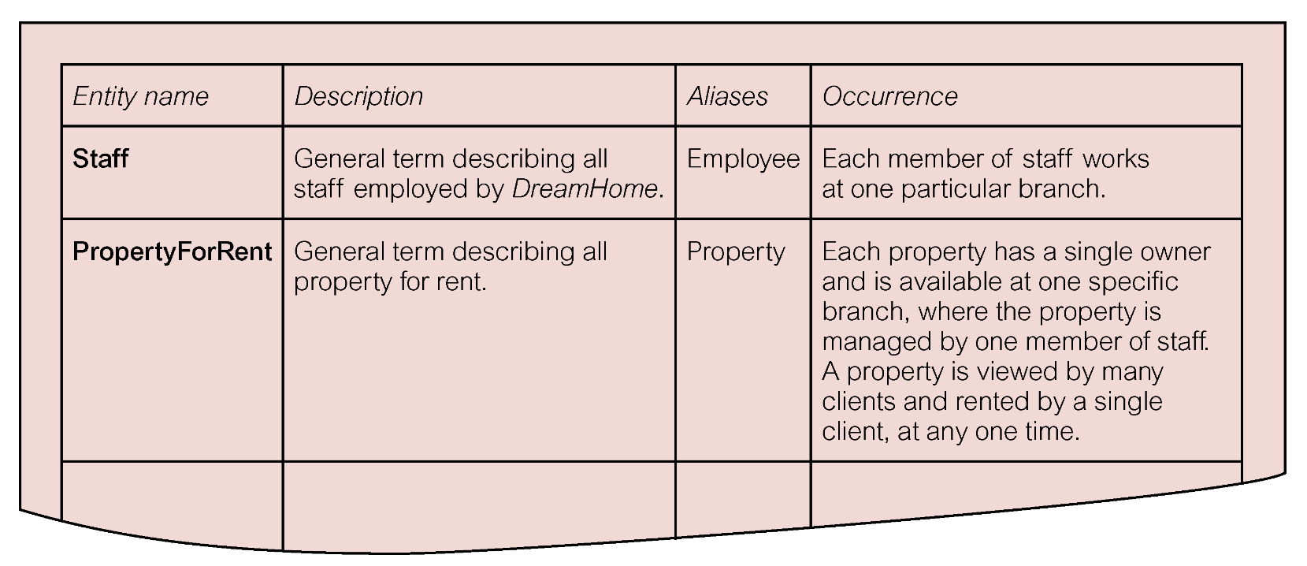
Conceptual Data Model Steps & Output (1/14)
Step 1.1: Identify entities and document them in Data Dictionary
  Example of data dictionary that documents the entities for Staff of DreamHome (Example as figure below)
Figure 1

Slide 60
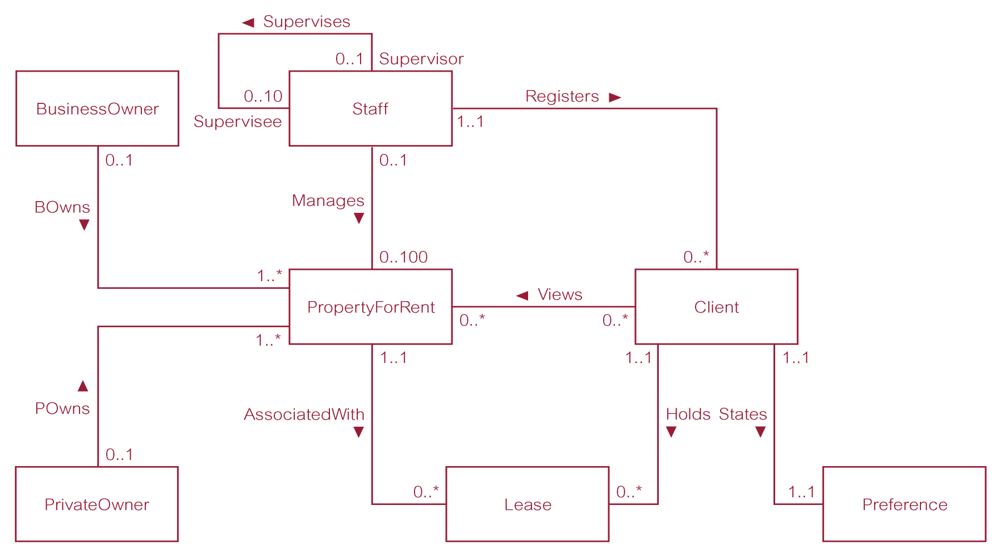
Conceptual Data Model Steps & Output (2/14)
Step 1.2: Identify relationship type between entities – show in ERM and Data Dictionary
  Example of ER diagram for Staff user views of DreamHome (Figure below)
Figure 2

Slide 61
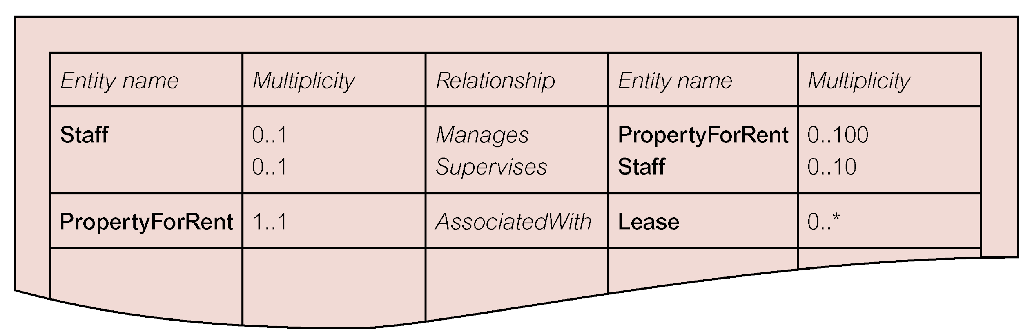
Conceptual Data Model Steps & Output (3/14)
Example of the data dictionary for the Staff of DreamHome showing the description of relationship
Figure 3

Slide 62
Conceptual Data Model Steps & Output (4/14)
Step 1.3: Identify and associate attributes with entity or relationship types
  To identify and associate attributes with the appropriate entity or relationship types and document the details of each attribute.
  How?
    Ask question: What information are we required to hold on each entity or attribute?
    Answer can be found in system’s specification and/or from users
  Determine attributes classifications: composite, single, multi-valued, derived
  Document the identified attributes (refer next slide)

Slide 63
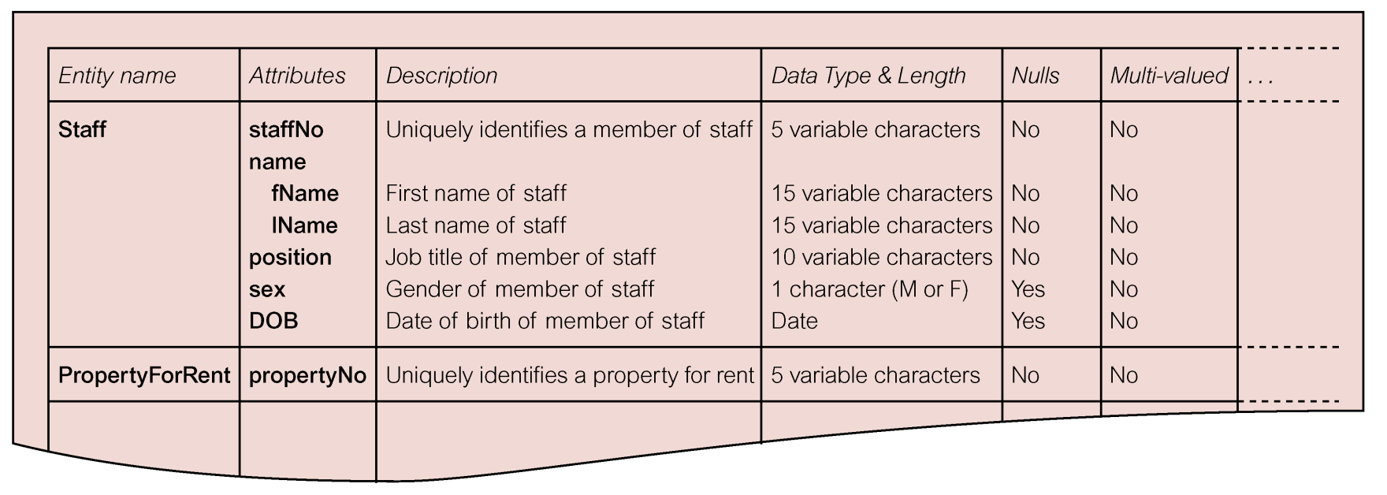
Conceptual Data Model Steps & Output (5/14)
Example of data dictionary for Staff of DreamHome showing the description of attributes
Figure 4

Slide 64
Conceptual Data Model Steps & Output (6/14)
Step 1.4: Determine attribute domains
  To determine domains for the attributes and document the details of each domain
  Example:
    “sex” attribute of the “Staff” entity as being either “M” or “F”. The domain of this attribute is a single character string consisting of values “M” or “F”.
  The domains for each attributes includes:
    Allowable set of values for attributes
    Sizes and format of the attribute

Slide 65
Conceptual Data Model Steps & Output (7/14)
Step 1.5: Determine candidate and primary key
  To identify the candidate key(s) for each entity and if there is more than one candidate key, choose one to be the primary key.
  Use following guidelines to help make the selection:
    The candidate key with minimal set of attributes
    The candidate key that is least likely to have its values changed
    The candidate key with fewest characters (textual attributes)
    The candidate key with smallest maximum value (numerical attributes)
    The candidate key that is easiest to use from the users’ point of view

Slide 66
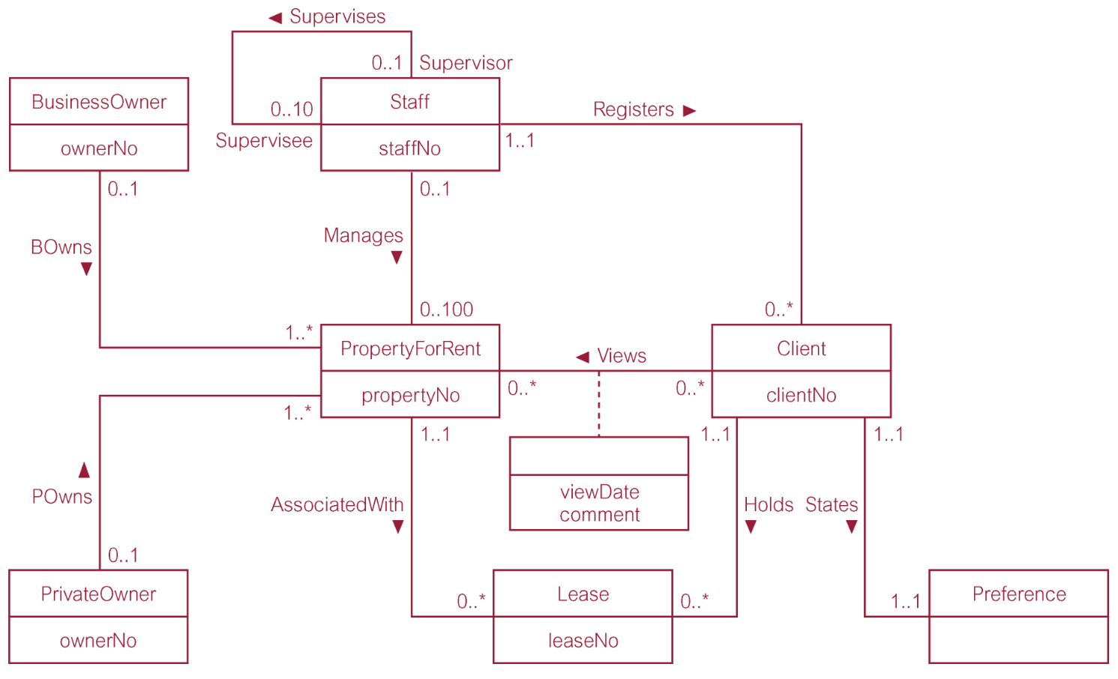
Conceptual Data Model Steps & Output (8/14)
Example of ER diagram for Staff user view of DreamHome with primary key added
Figure 5

Slide 67
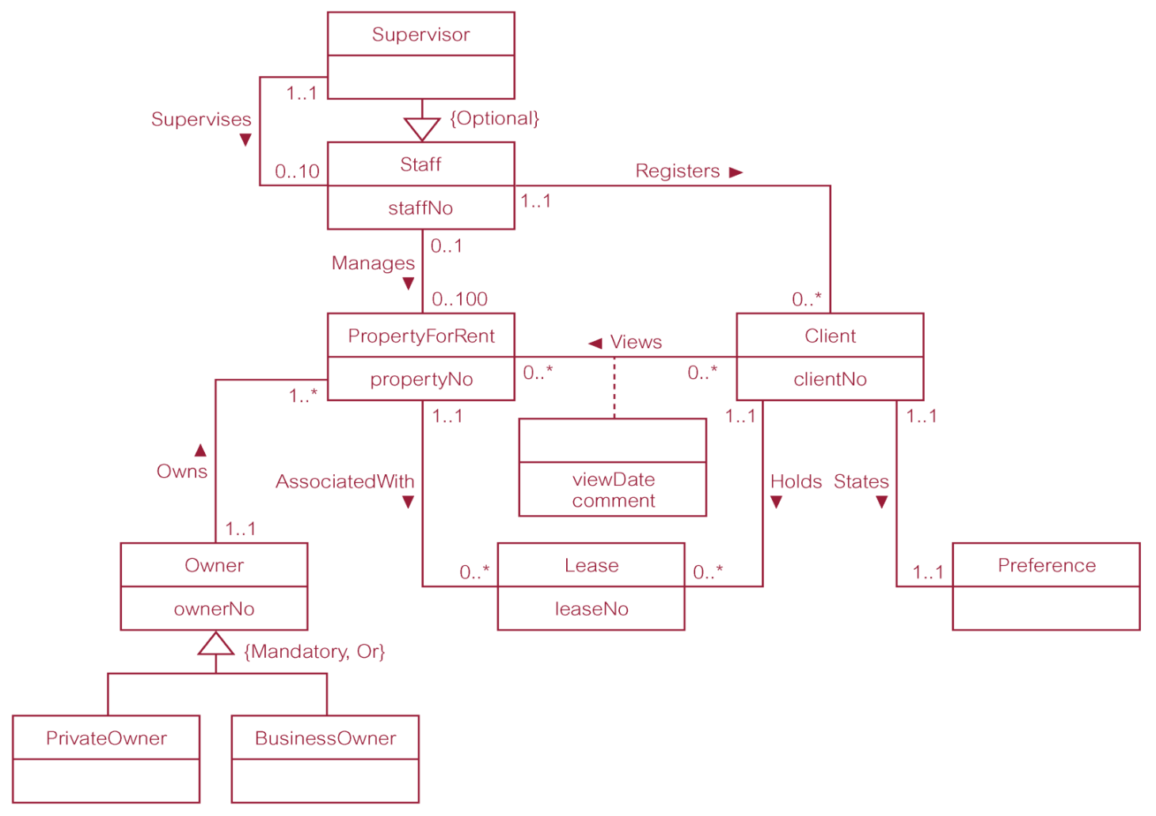
Conceptual Data Model Steps & Output (9/14)
Step 1.6: Consider use of enhanced modelling concepts (optional step)
Example of ER diagram for Staff user view of DreamHome with specialization / generalization
Figure 6

Slide 68
Conceptual Data Model Steps & Output (11/14)
Step 1.7: Check model for redundancy
  To check for the presence of any redundancy in the model.
  Activities in this step are:
    Re-examine one to one (1:1) relationships.
      Example: Staff and employee that are actually the same. In this case two entities should be merged.
    Remove redundant relationships.
    Consider time dimension.
      Example: Slide 19 shows the relationships between Man, Woman and Child. Consider the situation
    It is important to examine the meaning of each relationship between entities when assessing redundancy.

Slide 69
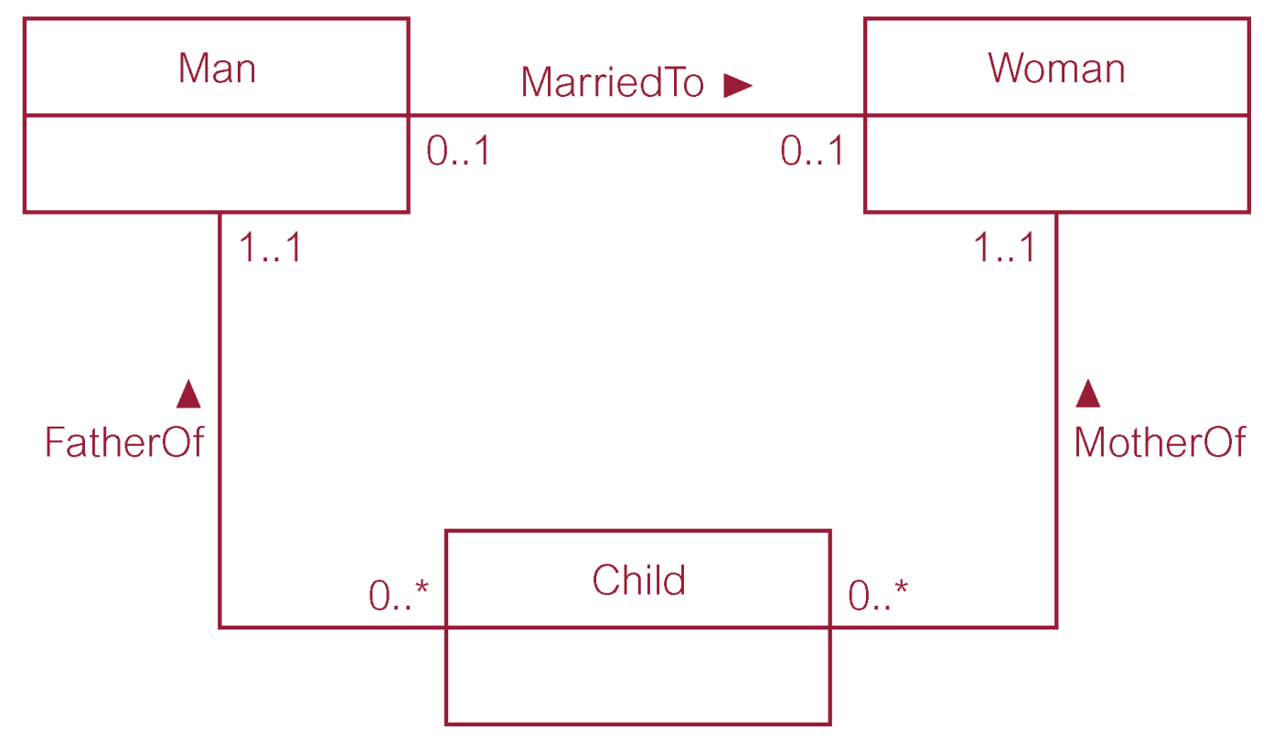
Conceptual Data Model Steps & Output (12/14)
Example of non-redundant relationship

Slide 70
Conceptual Data Model Steps & Output (13/14)
Step 1.8: Validate local conceptual model against user transactions
  To ensure that the model supports the transactions required by the view.
  Two approaches:
    Describing transactions.
    Example: Transaction (d) – List the details of properties managed by a named member of staff at the branch.
    Using transaction pathways.
    Example: Refer next slide.

Slide 71
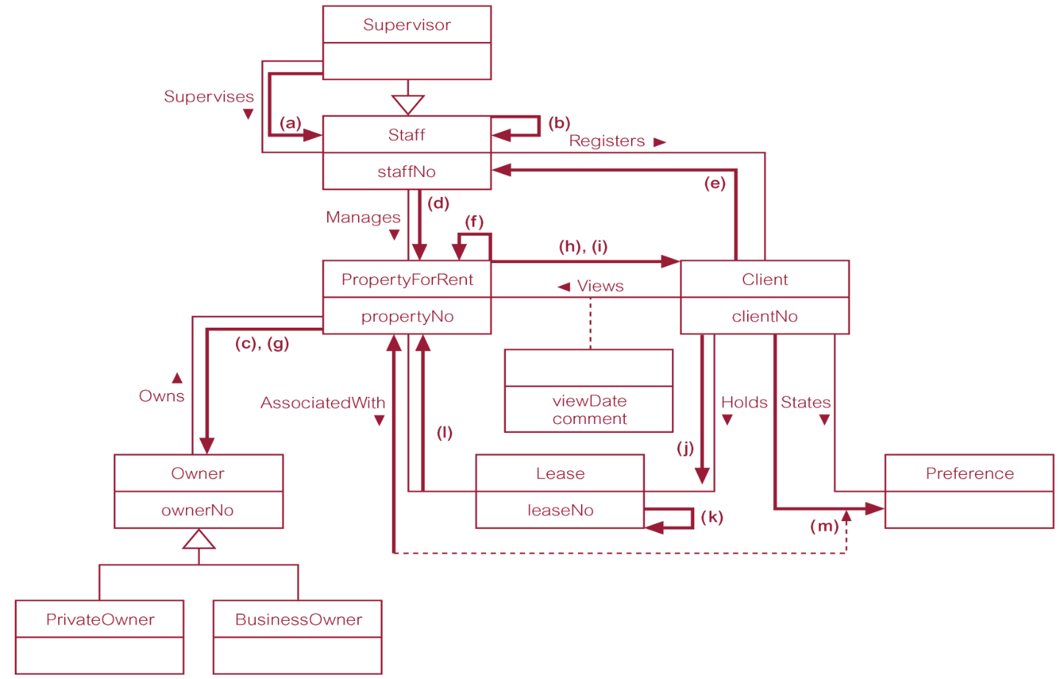
Conceptual Data Model Steps & Output (14/14)
Example of using pathway to check the model supports the user transaction for Staff user view
Figure 7

Slide 72
Summary (1/2)
Step 1.1
Identify entity types
Step 1.6
Consider use of enhanced modeling concepts (optional step)
Step 1.7
Check model for redundancy
Step 1.2
Identify relationship types
Step 1.5
Determine candidate and primary key attributes
Step 1.8
Validate local conceptual model against user transactions
Step 1.3
Identify and associate attributes with entity or relationship types
Step 1.4
Determine attribute domains
Step 1.9
Review local conceptual data model with user

Slide 73
Summary (2/2)
Steps | Output
1.1 | List of entities 🡪 initial data dictionary (DD - Fig 1)
1.2 | Relationships between entities 🡪 ERD (entity, relationship and multiplicity constraints are shown (Fig 2); a more complete DD (Fig 3)
1.3 | Attributes belong to entities & relationships 🡪DD (Fig 4)
1.4 | Domain for each attribute 🡪 a more complete DD
1.5 | Candidate keys and primary keys for every entity 🡪 ERD with PK (Fig 5)
1.6 | ERD or Enhance ERD (EERD – Fig 6)
1.7 | Revised ERD/EERD with no redundancies
1.8 | Validated (against user transactions ) ERD/EERD with pathways(Fig 7)
1.9 | Reviewed (with users) ERD/EERD

Slide 74


